Slide 1

National Coalition on Mental Health and Aging
and
National Council on Aging
Present
Mental Health First Aid for Older Adults
October 13, 2021

Slide 2
Tips for using Zoom
You have joined the webinar in listen-only mode.
The audio portion of this call will be heard through your computer speakers.
Please make sure your speakers are on and the volume is turned up!
Click the microphone at the bottom of your screen for instructions if you prefer to join by phone.
Type all questions into the Q&A box at the bottom of your screen.
The power point slides and recording will be uploaded in NCOA Connect web site (https://connect.ncoa.org/) in a few days.

Slide 3
Mission:
To provide opportunities for professional, consumer and government organizations to work together towards improving the availability and quality of mental health preventive and treatment strategies to older Americans and their families through education, research and increased public awareness.
Visit: www.ncmha.org

Slide 4
History, Membership and Activities:
Formed in 1991 by a group of organizations from the aging and mental health fields
Comprised of 100 national and state associations, state coalitions, and governmental agencies, e.g., SAMHSA and ACL.
Co-sponsor events to highlight challenges of mental health and aging
Identify new approaches to addressing problems.

Slide 5
National Council on Aging - Who we are
Vision
A just and caring society in which each of us, as we age, lives with dignity, purpose, and security
Mission
Improve the lives of millions of older adults, especially those who are struggling
Goal
Impact the health and economic security of 40 million older adults by 2030, especially women, people of color, LGBTQ+, low-income, and rural individuals

Slide 6
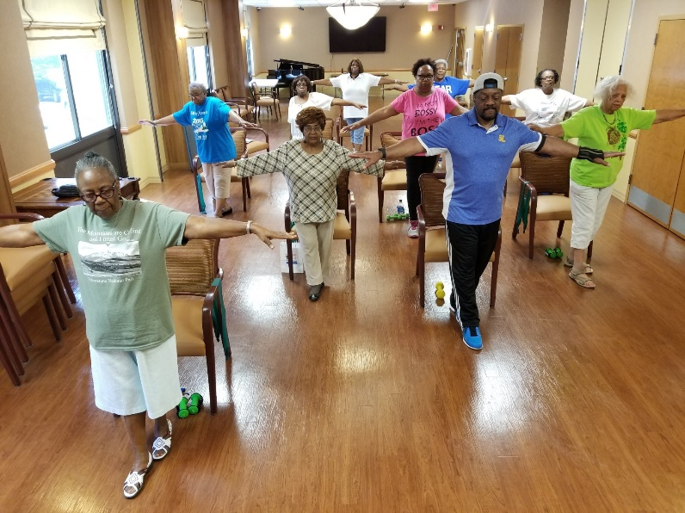
NCOA’s Center for Healthy Aging
Goal: Increase the quality and years of healthy life for older adults and adults with disabilities
Three national resource centers funded by the Administration for Community Living
Chronic Disease Self-Management Education (CDSME)
Falls Prevention
Modernizing Senior Centers
National Institute of Senior Centers
Other key areas: Aging Mastery Program, behavioral health, physical activity, vaccines

Slide 7
Promoting Mental Wellbeing in Older Adults
Anne Chapman, MPH - Director, Strategic Partnerships

Slide 8

National Council for Mental Wellbeing
Founded in 1969, the National Council for Mental Wellbeing is a membership organization that drives policy and social change on behalf of nearly 3,500 mental health and substance use treatment organizations and the more than 10 million children, adults and families they serve.

Slide 9
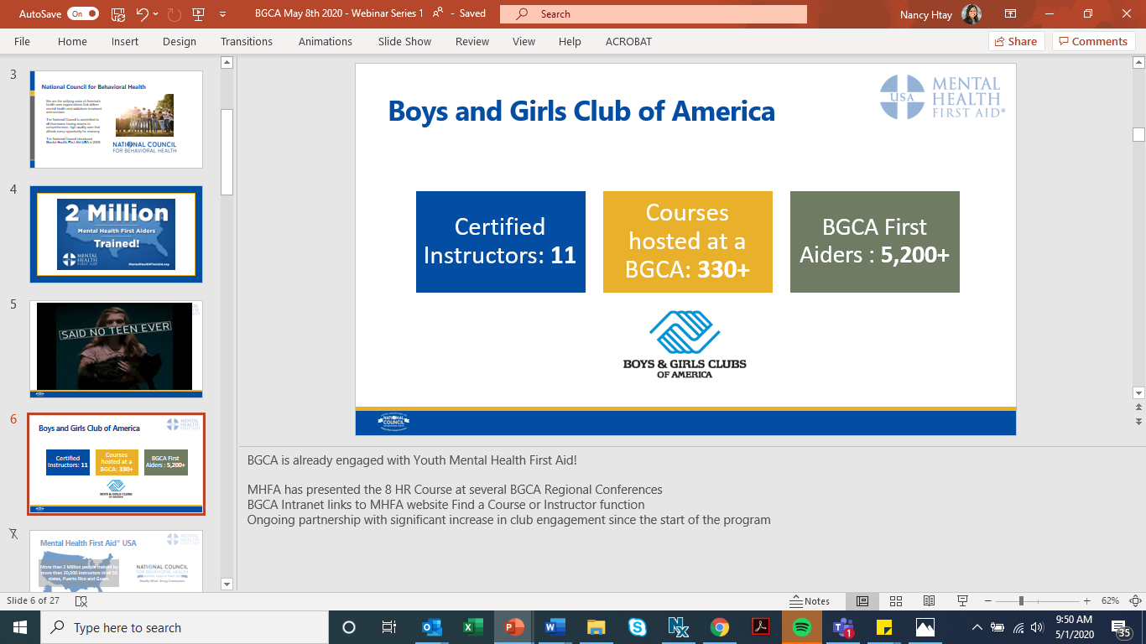

Trauma Defined:
Individual trauma results from an EVENT, series of events, or set of circumstances that is EXPERIENCED by an individual as physically or emotionally harmful or life threatening and that has lasting adverse EFFECTS on the individual’s functioning and mental, physical, social, emotional, or spiritual well-being.
©MENTAL HEALTH FIRST AID® USA 2020
Notes:
As defined by SAMSHA; Trauma simply is anything that overwhelms a persons capacity to cope.
Three E’s of trauma:
Event – this can be anything! (i.e. loss of a job, extreme working conditions, $$ Pandemic)
Experience – what the person felt, their view of what happened to them
Effect – Impact that what happened to a person has on how they now experience their world. (i.e. mental, physical, social, emotional, spiritual)

Slide 10

Impact of Trauma
Perception of trauma varies among individuals
Anxiety is a NORMAL response to an ABNORMAL experience
Trauma is something that overwhelms our coping capacity
Affects the whole self
Physical
Emotional
Intellectual
Spiritual
©MENTAL HEALTH FIRST AID® USA 2020
Notes:
Trauma can have both short- and long-term effects, and impact may not be immediately recognized.
Trauma may affect an individual’s physiological responses, psychological well-being, social relationships, and/or spiritual beliefs.
Short and long term effects hinder an individuals persons ability to have a sense of control, connection and meaning.

Slide 11

Normal Response to Traumatic Events
Feelings become intense and sometimes unpredictable
Thoughts and behavior patterns are affected
Recurring emotional reactions are common
Interpersonal relationships often become strained
Physical symptoms may accompany the extreme stress
©MENTAL HEALTH FIRST AID® USA 2020

Slide 12
The Challenge We Face
Despite overwhelming need, nearly 30 million people across the U.S. don’t have access to comprehensive, high-quality, affordable mental health and substance use care when they need it. This has a profound and direct impact on adults over the age of 65.
15%
About 15% of adults aged 60 and over have a mental disorder.
1M
More than 1 million people aged 65 or older had a substance use disorder in 2014.
5.7M
The addiction rate for Americans aged 50 and older is expected to almost double to 5.7 million by 2020.

Slide 13

It Doesn’t Have to Be This Way
Research shows early intervention, education, and being open about mental health can all help.
Increase knowledge of signs, symptoms and risk factors of mental illnesses and addictions.
Ability to identify professional and self-help resources for individuals with a mental health or substance use challenge.
Increase confidence in and likelihood to help an individual in distress.
Show increased mental wellness themselves.

Slide 14
The National Council introduced Mental Health First Aid USA (MHFA) in 2008. Through MHFA, we have trained more than 2.5 million people in the U.S. to identify, understand and respond to signs and symptoms of mental health and substance use challenges.
Mental Health First Aid® is the help offered to a person experiencing a mental health challenge, mental disorder or a mental health crisis. The first aid is given until appropriate help is received or until the crisis resolves.

Slide 15
The Path to a Brighter Future
Mental health challenges are common.
Learn how to notice when someone needs help.
Stigma is associated with mental health challenges.
Promote better understanding.
Professional help is not always on hand.
Encourage community members to support one another.
Individuals often do no seek help.
Equip community members with information about getting help.
Many people don’t know how to respond to mental health challenges.
Early intervention makes a difference. Learn how to intervene to save lives.

Slide 16
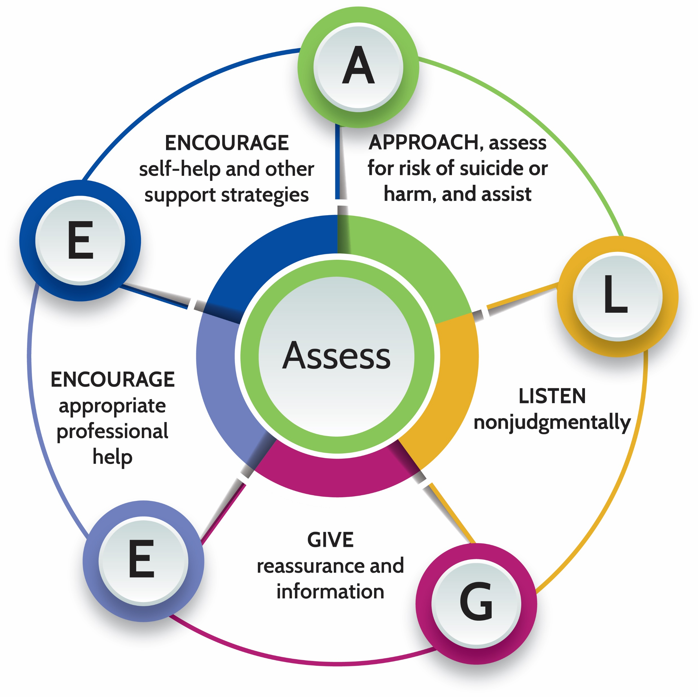
Implementing the Solution
Risk factors and warning signs of mental health and substance use problems.
Information on anxiety, depression, trauma, substance use (including opioids), non-suicidal self injury, disorders in which psychosis may occur, disruptive behavior disorders and eating disorders.
A 5-step Action Plan to help someone who is developing a mental health problem or is in crisis.
Available evidence-based professional, peer and self-help resources.

Slide 17
What to look for…
Signs
What we may see
Symptoms
What someone may feel
Weight change
Sadness/anxiety
Withdrawal from others
Low energy
Irritability
Sleep disturbance
Changes in self-care/appearance
Appetite change
Headaches
Personality change
Need for more of the substance over time
Tearfulness
Physical Withdrawal
Indecisiveness/confusion
Unexplained aches and pains
Increased alcohol or drug use
Hopelessness
Having a dramatic change in mood
Helplessness
Self-criticism
Thoughts of death and suicide
©MENTAL HEALTH FIRST AID® USA 2020
Notes:
Let’s review some of the signs and symptoms of potential mental illnesses, substance use disorders or suicide risk:
People with depression and other mental health disorders do not necessarily have all the signs and symptoms listed, but this may help you understand what to look for—what could be a warning sign of something serious.
Early intervention can prevent many of the long-term effects on a person’s physical and mental health, social relationships, educational progress, financial stability, and employment
For this reason, it is important to notice any changes—especially those related to hopelessness and helplessness as this can lead to thoughts (or discussion) of death and suicide

Slide 18
Activity: Helpful vs Unhelpful Approaches

Slide 19
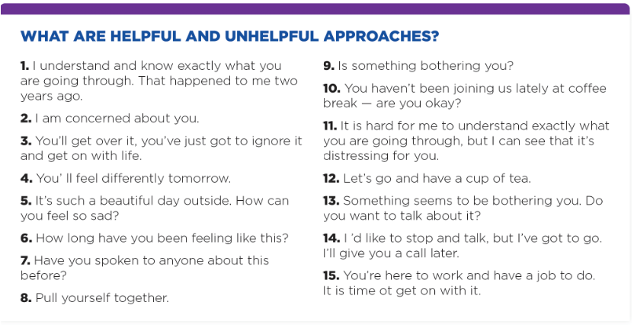

Slide 20
Tips to Get Started
Use this guidance from the MFHA curriculum about what is and isn’t supportive when trying to talk to someone who may be struggling. The key is to treat others with dignity, respect, acceptance, and consistent emotional support.
SAY THIS
NOT THAT
“Are you okay?”
“Are you thinking about suicide?”
“I’ve noticed that…”
“How are you, really?”
“Do you want to take a walk?”
“Snap out of it”
“Get over it”
“Smile”
“Lighten up”
“You don’t seem that bad”
“Get your act together”

Slide 21
Curricula Options
CURRICULA
Adult Mental Health First Aid
Youth Mental Health First Aid
Teen Mental Health First Aid
18+ ENGLISH and SPANISH
Adults → K-12 ENGLISH and SPANISH
Teens → Grades 10-12
MHFA DELIVERY PATHWAYS
In-Person*
Virtual
Blended
6.5-8 hours
ADULT/ YOUTH/ TEEN
2 hours self-paced + 6 hours video conference
ADULT/ YOUTH/ TEEN
2 hours self-paced + 4 hours in person
ADULT/ YOUTH
*Please note that all Instructor trainings are currently conducted in a virtual format.​

Slide 22



Curricula Enhancements (2020)
Manual Updates
Participant Processing Guides
Centralized Crisis Sections
Cultural Considerations
Impact of Trauma
Recovery
Self-Care
22
Notes:
DSM-5 + Additional information on the areas outlined
Early, Worsening and Crisis Signs and Symptoms (Builds)
Participant Processing Guide: Includes the course handouts and space for taking notes during activities such as:
Case scenario practice
Action steps for self-care
Resources
Key Takeaways

Slide 23






Adult Curriculum Supplements
Customized outreach to specific audiences
Tailored content including scenarios
Population-specific resources and statistics
Notes:
Remember that audiences can include:
Law enforcement and emergency services personnel
Families, caregivers, and service providers
Parents and caregivers of children and youth with a serious emotional disturbance or youth experiencing a first episode of psychosis.
Options are far-reaching
Provide organizations with the ability to provide customized outreach to specific audiences
Content is tailored including scenarios
Population specific resources and statistics are provided
A series of cultural considerations guides provide guidance on the delivery of MHFA to diverse communities and providing foundational understanding to our instructors of our expectations in culturally relevant and congruent course delivery

Slide 24
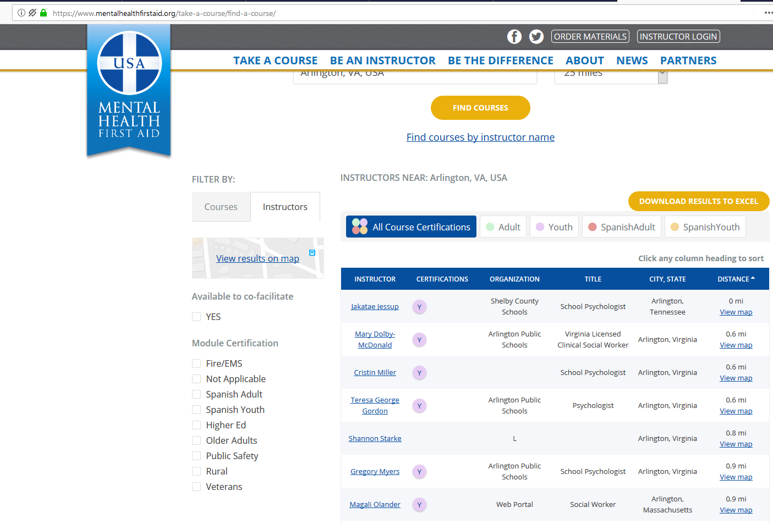
How to Find Area Courses or Instructors
Go to www.mentalhealthfirstaid.org and click “Find a Course”
Search by City, State or by Zip code and select the search area (“Distance from Me”)
A list of courses will appear. Click “Download to Excel” to download search results
Click tabs to see either Courses or Instructors
Download Search Results
Click to filter by curriculum type (optional)
To see a list of Instructors, click the Instructors tab. If desired, filter instructors by Certification. Click “Download to Excel” to download search results
Click to filter by module type
(optional)
©MENTAL HEALTH FIRST AID® USA 2020
24
Notes:
You can be the difference in your community by taking a course or event becoming an instructor.
Courses are often free or low cost and can be found in your local community
Rates average from $0-50 nationally as courses are often subsidized by organizational or foundation support. Mental Health First Aid is a low-cost, high-impact program that helps people understand that mental health and substance use problems are real, common, and treatable and that it is okay to seek help

Slide 25
Mental Health Resources
Learn more about getting trained in Mental Health First Aid at mentalhealthfirstaid.org.
Adult Mental Health First Aid for ages 18+ (offered in English and Spanish)
Youth Mental Health First Aid for adults working with youth (offered in English and Spanish)
Teen Mental Health First Aid for teens grades 10-12 (offered in English)
Suicide Prevention Lifeline: 1-800-273-TALK (8255) → Dial 911 in case of emergency
Blog posts with practical tips: mentalhealthfirstaid.org/news-and-updates/
Mental health self-screening tests: screening.mhanational.org/

Slide 26

Questions?

Slide 27
Thank You!
Don’t hesitate to reach out:
partnerwithus@mentalhealthfirstaid.org
hello@mentalhealthfirstaid.org

Slide 28


Karen Orsi
Director
Oklahoma Mental Health
and Aging Coalition
kareno@northcare.com
www.omhac.org
NorthCare
2627 General Pershing Blvd.
Oklahoma City, OK 73107

Slide 29


Slide 30
MENTAL HEALTH FIRST AID FOR ADULTS
PROGRAM OVERVIEW
SESSION I
What is Mental Health First Aid?
Mental Health Problems in the United States
Mental Health First Aid Action Plan
Understanding Depression and Anxiety
Mental Health first Aid Action Plan for Depression and Anxiety
Suicidal Behavior
Depressive Symptoms
Non-suicidal Self-Injury

Slide 31
MENTAL HEALTH
FIRST AID FOR
ADULTS
PROGRAM OVERVIEW
SESSION 11
Panic Attacks
Traumatic Events
Anxiety Symptoms
Understanding Psychosis
Mental Health First Aid Action Plan
Acute Psychosis
Disruptive or Aggressive Behavior
Understanding Substance Use Disorders
Mental Health First Aid Action Plan
Overdose
Withdrawal
Substance Use Disorders
Using your Mental Health First Aid Training

Slide 32
MENTAL HEALTH FIRST AID FOR OLDER ADULTS
WHO SHOULD TAKE IT
CONTENTS
Stigma and Ageism
Life changes and transitions
Risk factors
Suicide ideation vs. thoughts about
death/dying
Psychosis, Delirium, Dementia
Culturally sensitive and respectful
communication
Mental Health Disorders
Substance Use, Misuse and Abuse
Older Adults
Families
Caregivers
Nursing Staff
Aging Service Providers
Police, Fire, EMT
Gatekeepers

Slide 33
MHFA for OLDER ADULTS Training Content
Session One
Session Two
What is mental disorder/ Who can diagnose
Prevalence
Disability and recovery
MHFA Action Pan
Depression signs and symptoms
Anxiety disorders/ signs and symptoms
Risk factors for depression and anxiety
Suicide/ assess for risk/ myths and facts/ warning signs/actions
Non-suicidal self injury/reasons/ medical emergencies
Panic attacks
Trauma and impact of traumatic events
Psychosis/myths and misunderstandings
Dementia and Delirium
MHFA for Psychosis
Substance Use disorders/ FAQs about alcohol/ risk factors
MHFA for Substance Use/ stages of change
ALGEE Plan

Slide 34
Exercises and Videos
Brainstorm negative terms for mental health/ persons with mental health or substance use disorder
Brainstorm stigmatizing language/ person friendly language
Pain of Depression DVD
Illustrations of anxiety/ mental and physical signs and symptoms
Helpful and unhelpful things to say
Suicide – practice asking the question
Panic attack demonstrations – mental and physical signs and symptoms
Auditory hallucination exercise
DVD – Mental Health First Aid for Psychosis
Neutral stance demonstration
Demonstration of recovery position
ALGEE Plan

Slide 35
KEY MESSAGES Session 1 – Part 1
Chronological age – 60
Impact on other health conditions, functioning, activities of daily living, isolation
Unconnected to mental health network
Most common conditions-anxiety, cognitive impairment, depression
Prevalence higher with physical illnesses; receiving services from aging network
Depression estimates: 48% in assisted living; 60% in nursing homes
Recovery possible; resiliency may need support
Age related health and psychosocial changes
Unaddressed mental health – worsen symptoms of chronic conditions, increase health care costs, loss of independence
Majority do not experience disorders; disorders unidentified, untreated; les than40% get treatment; utilize primary care
Impact of life changes
Fact Sheet Handout – Overview of Late-Life Behavioral Health

Slide 36
KEY MESSAGES SESSION 1 – Part 2
Depression most prevalent
Not a normal part of aging
Treatable; often unrecognized
Symptoms take greater toll on aging vs younger
Anxiety – symptoms and impact
Present as aches/pains, not tearfulness, sadness
Symptoms not recognized as mental disorder
Risk factors for depression and anxiety
High suicide rate; first attempt is fatal
Frailer, more isolated, determined
Older white males have highest rate
Access to deadly means
Risk factors-chronic illness, disability, pain, meds, life events, anxiety, depression
Suicide risk assessment
Warning signs of suicide
Normative thinking about morality vs. suicidal ideation
Impact of culture
Ageism
Self-injury and elder abuse
Geriatric professionals

Slide 37
KEY MESSAGES SESSION 2 – PART 1
Always consider and involve physical health – heart attack vs. panic attack
Trauma impact
Schizophrenia and Bipolar disorder
Delirium and dementia rates higher, often include psychosis
Psychosis risk factors, symptoms
Types of disorder in which psychosis may occur
Symptoms of dementia
Characteristics of dementia-brain disease shares many symptoms with mental illnesses
Alzheimer’s disease
MHFA recommendations for Dementia and advanced dementia
Symptoms of delirium
Dementia and delirium fact sheet handout

Slide 38
KEY MESSAGES SESSION 2 – PART 2
Effects of alcohol and drugs on aging bodies
Age related changes
Stigma and shame
When medical attention is necessary
Recommendations for alcohol consumption
Adverse events – meds, alcohol, medical conditions
Understanding Substance Use disorders
Age related changes elevate risks; loneliness; self-medication
Standard diagnostic criteria difficult to apply
Under-identification of substance use disorders
Professional help
Substance Use Disorders Fact Sheet Handout

Slide 39
COMPARISON
MENTAL HEALTH FIRST AID - ADULTS
MENTAL HEALTH FIRST AID – OLDER ADULTS
Mental health disorders – signs and symptoms
Impact of culture/awareness/communication
Ethnicity, religion, Veterans, Gender Identity, Minorities, Male, Female, etc.
Stigma
Mental Health First Aid Action Plan - ALGEE
ADDITIONALLY
Cultural competencies encompassing 4-5 decades of older adult experience
Physical health considerations
Overlapping symptoms
Stigma
Ageism
Delirium
Dementia
Age related substance use issues

Slide 40

Mental Health First Aid Action Plan
Assess for risk of suicide or harm
Listen nonjudgmentally
Give reassurance and information
Encourage appropriate professional help
Encourage self-help and other support strategies
ALGEE
13

Slide 41
